Slide 1
BSc COMPUTING - WEB PROGRAMMING GROUP PROJECT
By Jed Powell, Joseph Elec and Dariusz Kwiatkowski (Group 5)
Notes:
We are Group 5 and welcome you to the unveiling of our group project.

Slide 2
Objectives
To create a website that delivers a booking system
Three modes of transport to select from: plane, train and taxi
Printable booking results with the option to download a receipt
Notes:
A few objectives were laid out for us order for us to achieve our vision. First and foremost, we needed to create a website with a functional booking system. This system would offer a choice of transportation from plane, train and taxi. For each of these the date, time and number of passengers would be selected then costs, availability and times would be displayed to the user. Should the user proceed to book travel, results from booking could be downloaded as a txt file and printed.

Slide 3
DESIGN
The ‘Grand Travel Booking’ Website
Clean, minimalist design
Ease of use to web users of all backgrounds
Uncluttered and clear forms and booking results
Stylish colour scheme easy on the eyes
Notes:
For each of our travel modes work on individually we had our own personal objectives, but as a group we had these in mind. A clean design can give an air of professionalism and was a common theme found when researching other websites. Since we won’t have a lot of data to display, a graceful design seemed the best approach. It also seemed most practical in order to create an easy-to-use web environment for all users, thinking about perhaps the elderly who may only become overwhelmed with too many links, information and much going on. Continuing this theme, the forms should be uncomplicated and booking results laid clearly. And finally, a colour scheme or style to catch the eye and make users comfortable.

Slide 4
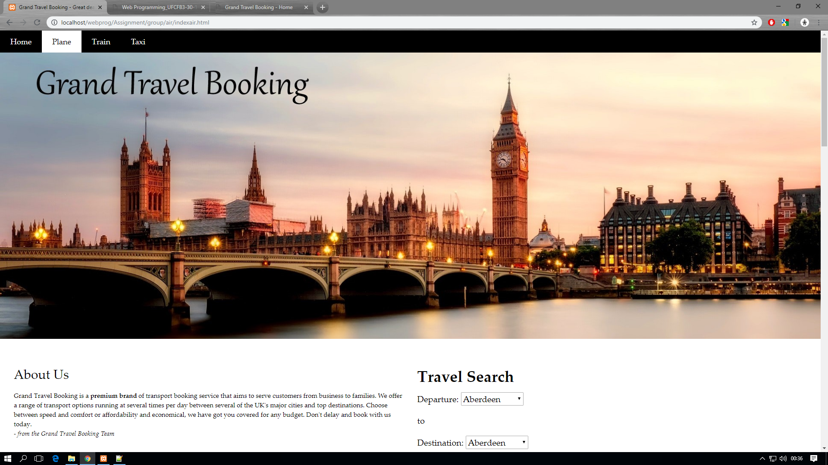
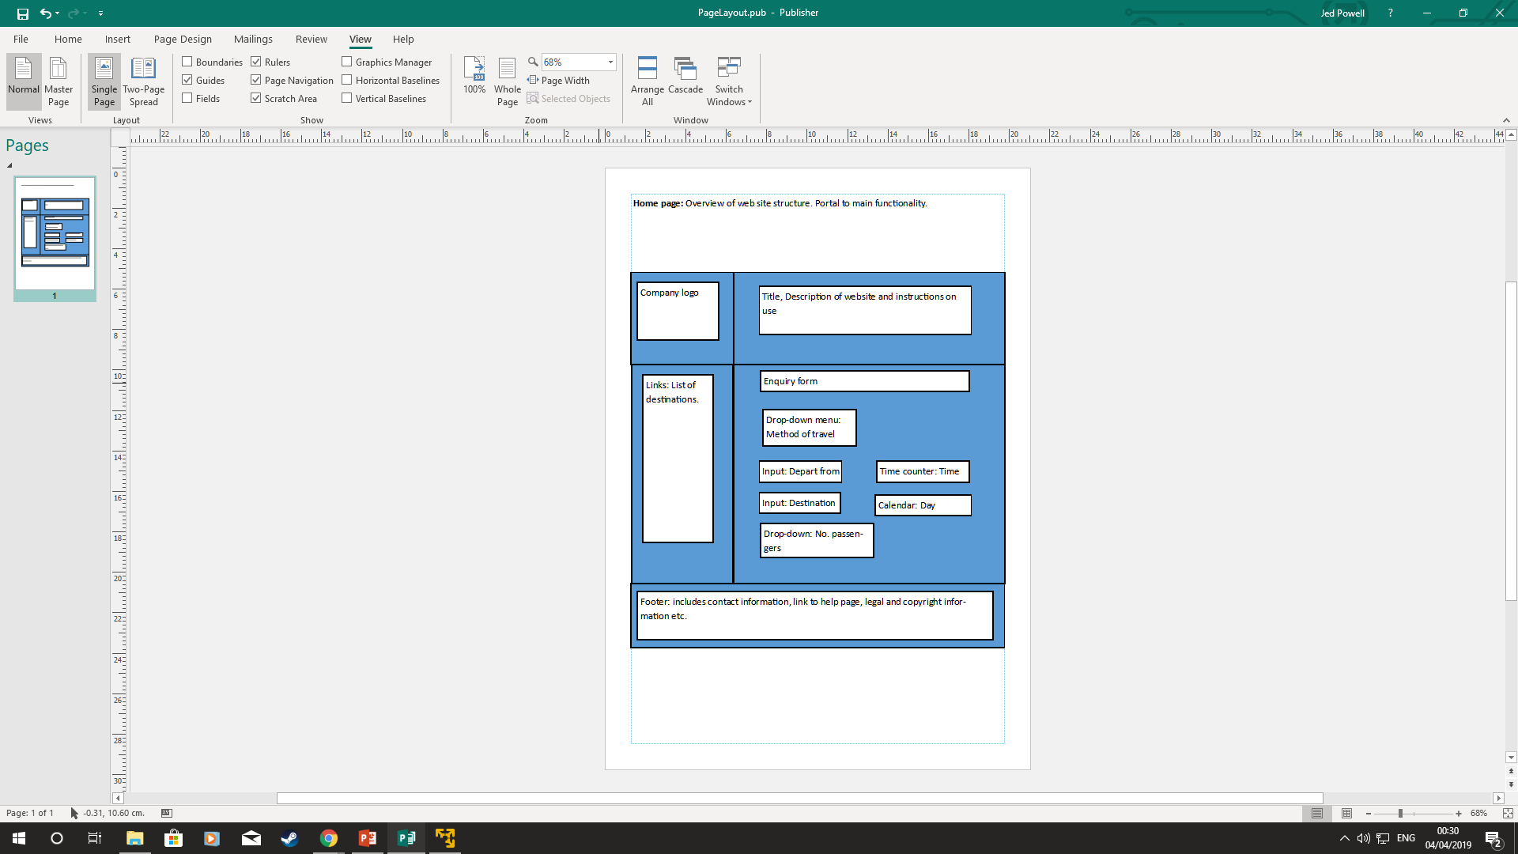
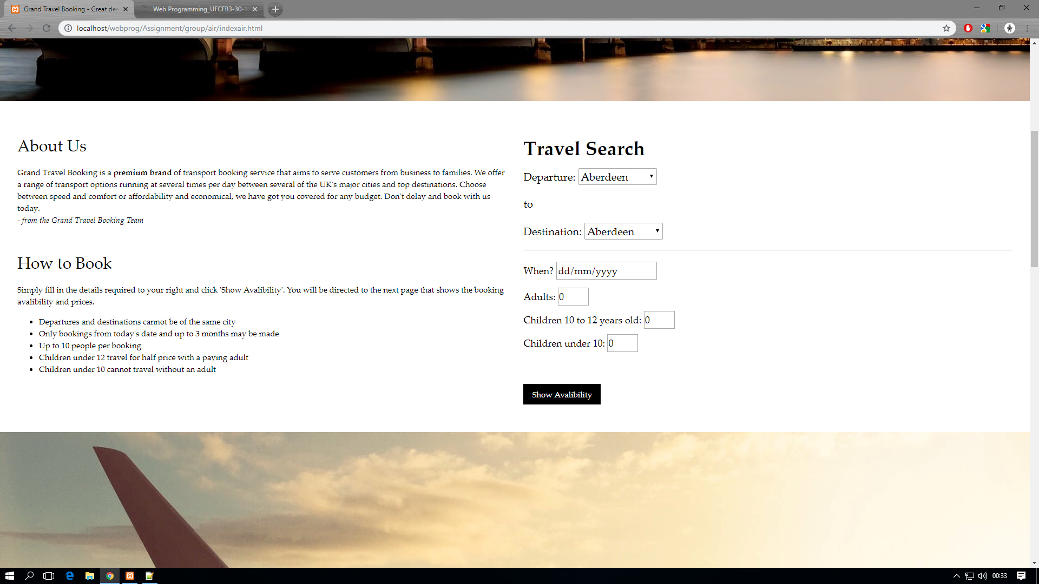
COMPONENT 1 – PLANS AND FINAL PRODUCT
- Layout changed but retains core functionality envisioned

Slide 5
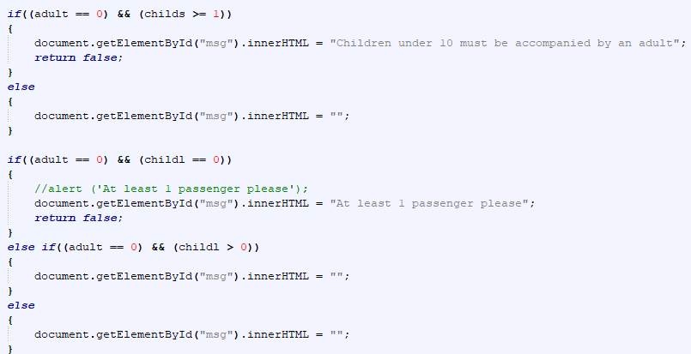
COMPONENT 1 – PROBLEMS/SOLUTIONS
PROBLEM 1: Forms could pass any values, often resulting in errors or blank spaces
SOLUTION: JavaScript – used to regulate form entry and prevent errors
PROBLEM 2: Unappealing and hard to work with stylesheet
SOLUTION: w3.css + w3template – gave a bootstrap-like experience with a solid foundation of which to base the website on, adapt and grow.

Slide 6
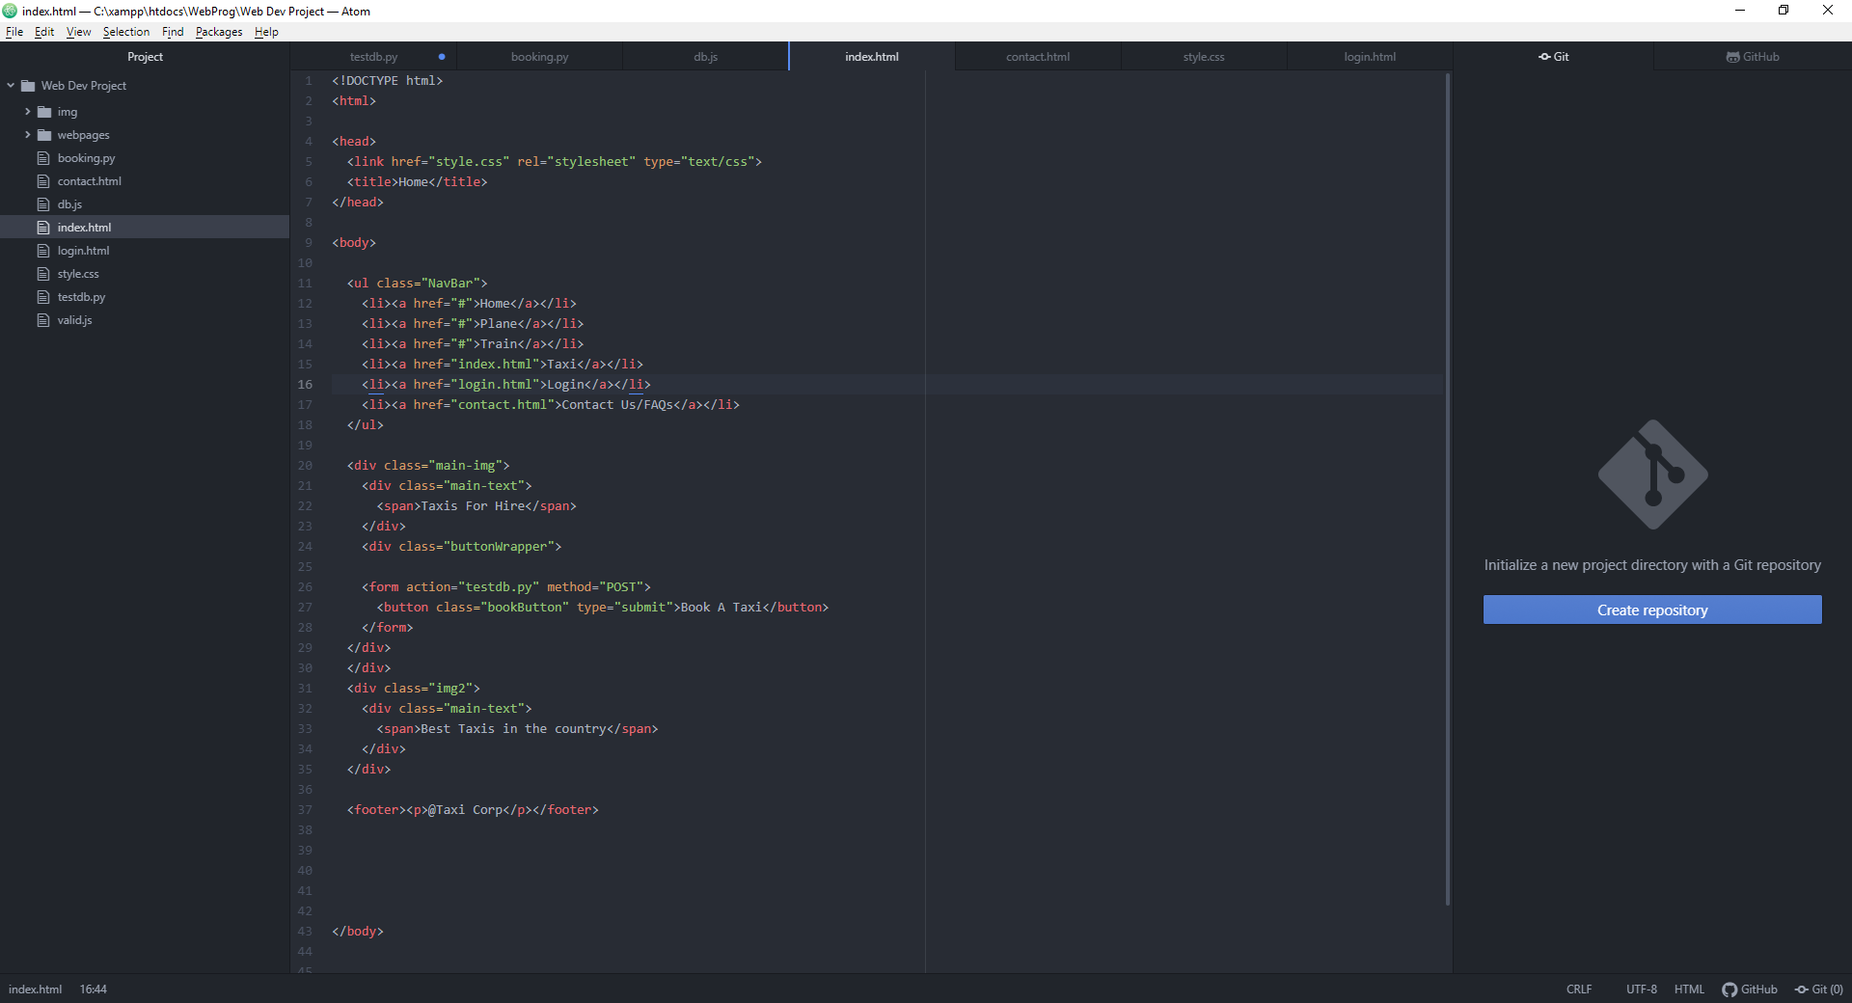
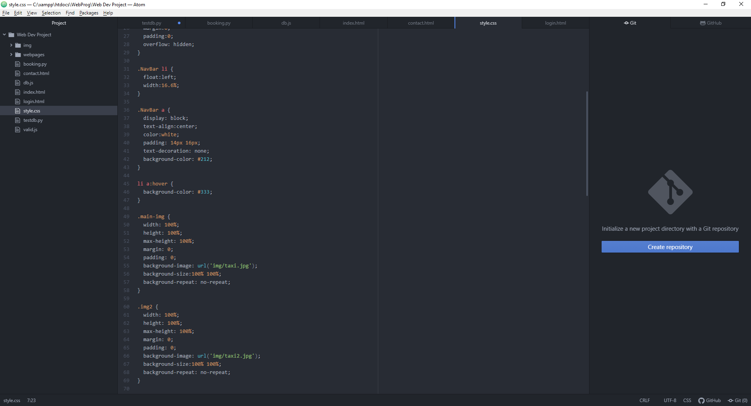
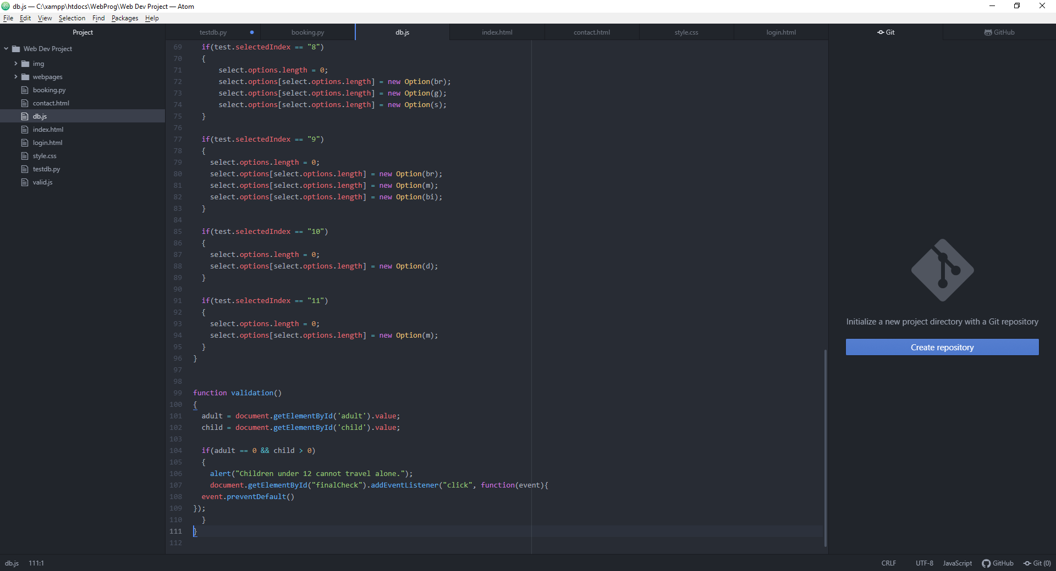
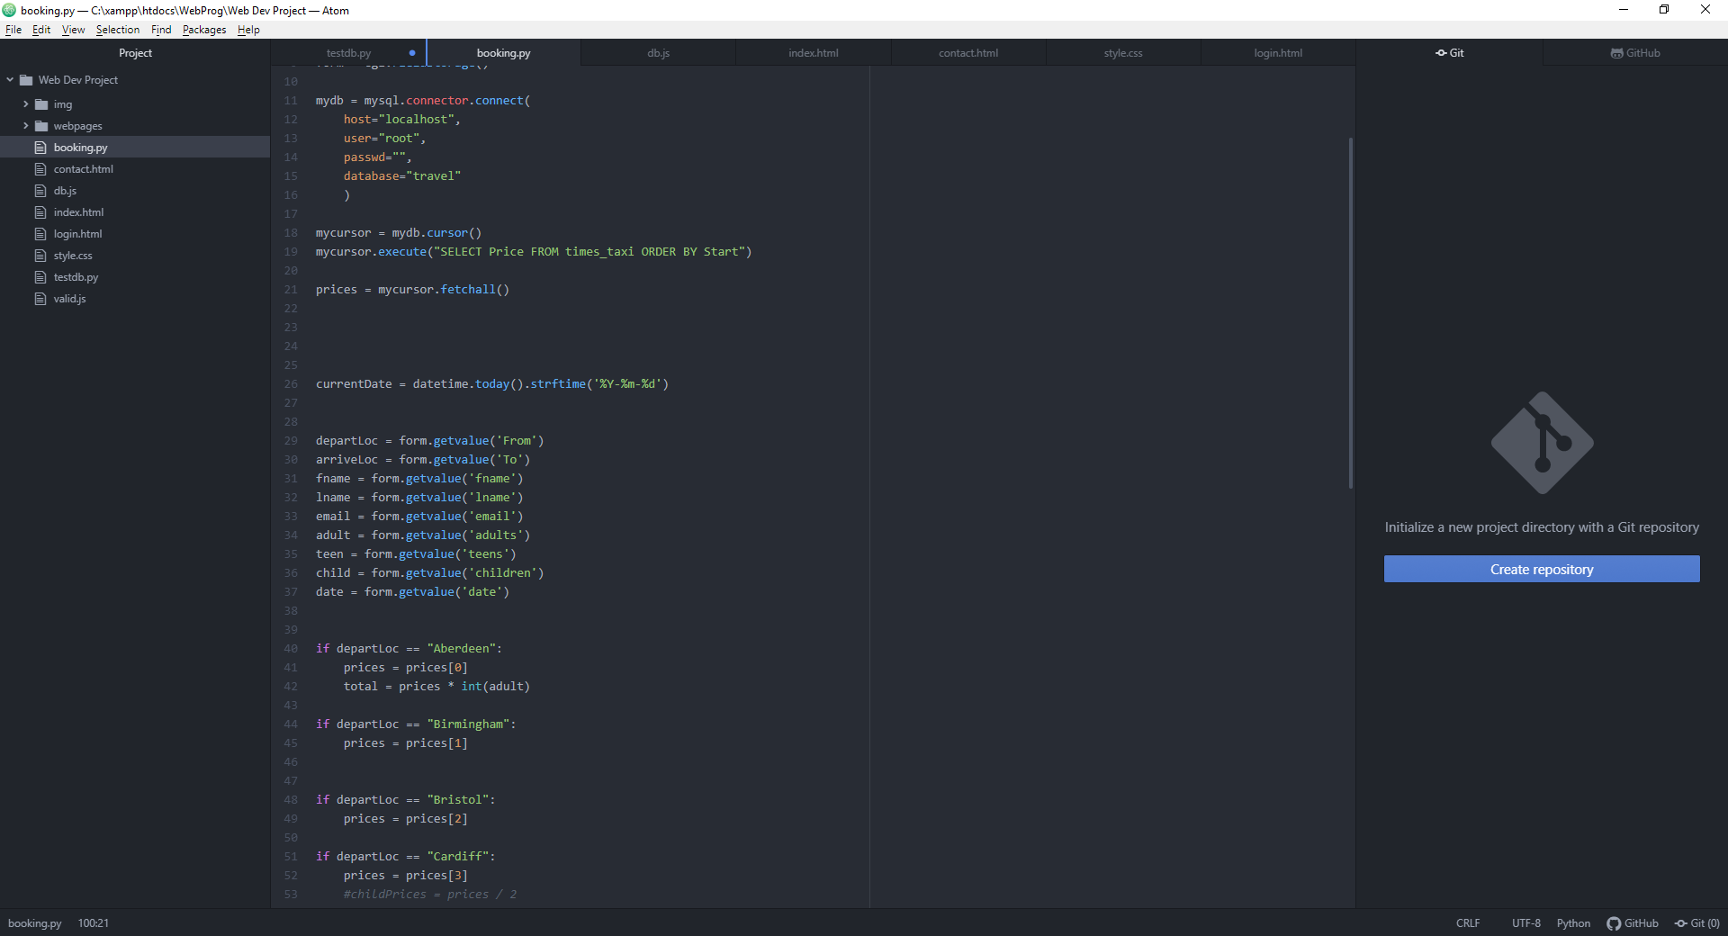
Taxi
Taxi
HTML
CSS
I have worked on the Taxi mode in our group.
These are the technologies I have used to achieve my vision: HTML as it structures the webpage,
CSS to style the html and make the webpages presentable,
Javascript for validation,
Python CGI for connecting to the database,
MySQL to store information such as the travel times and locations.
Javascript
Python CGI

Slide 7
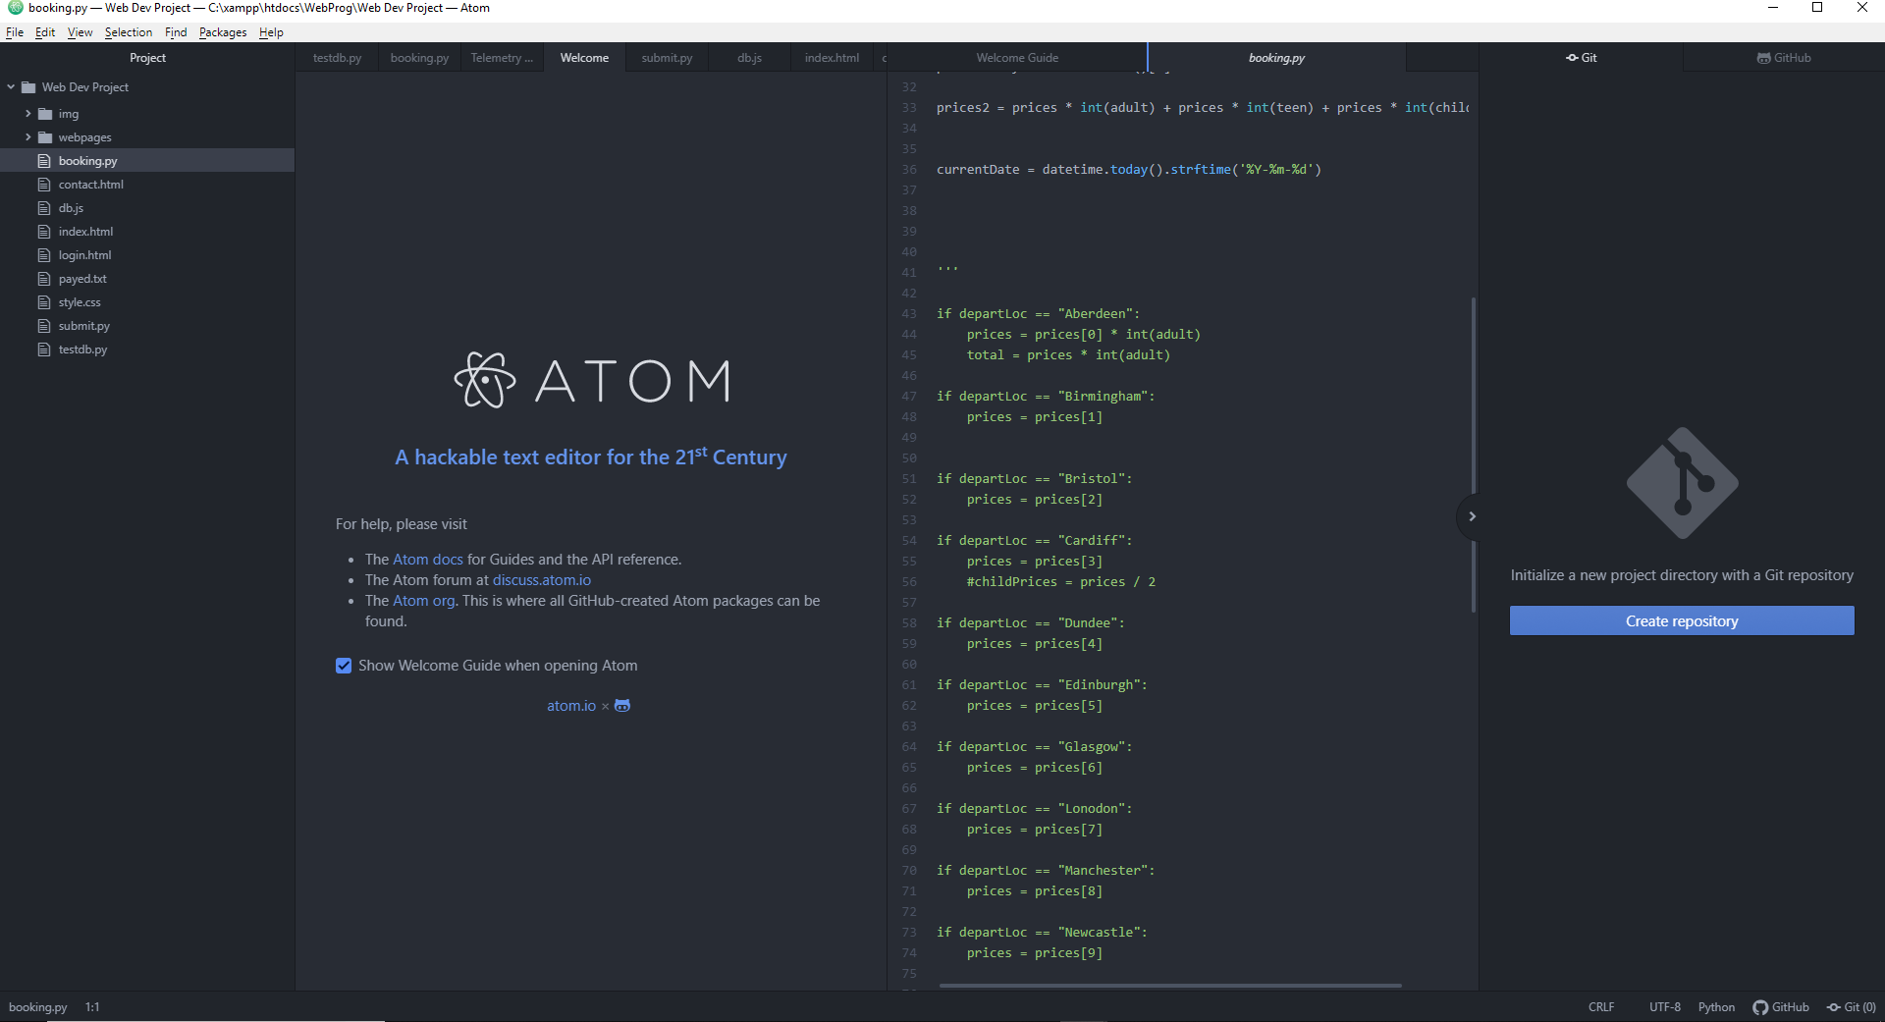
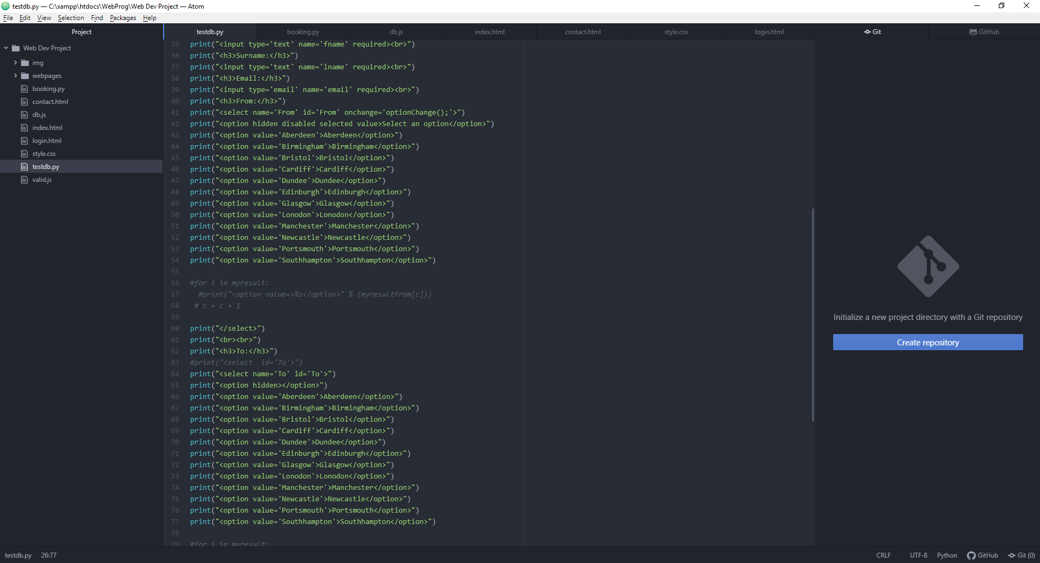
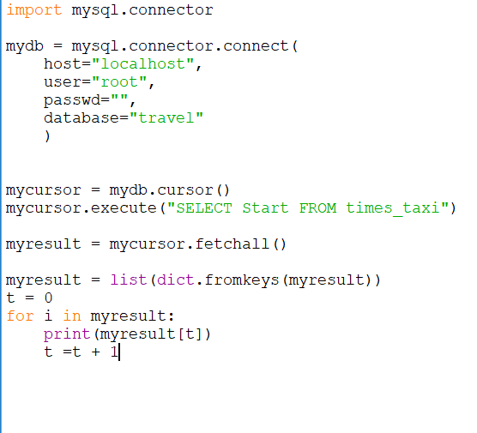
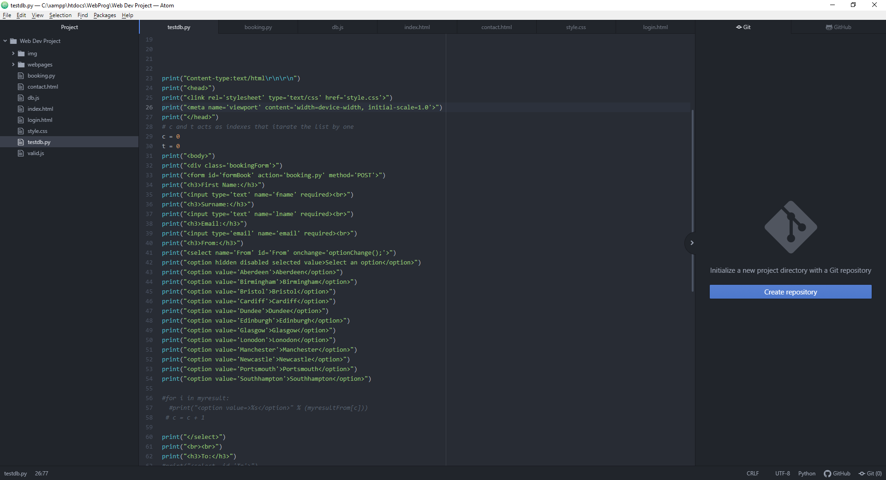
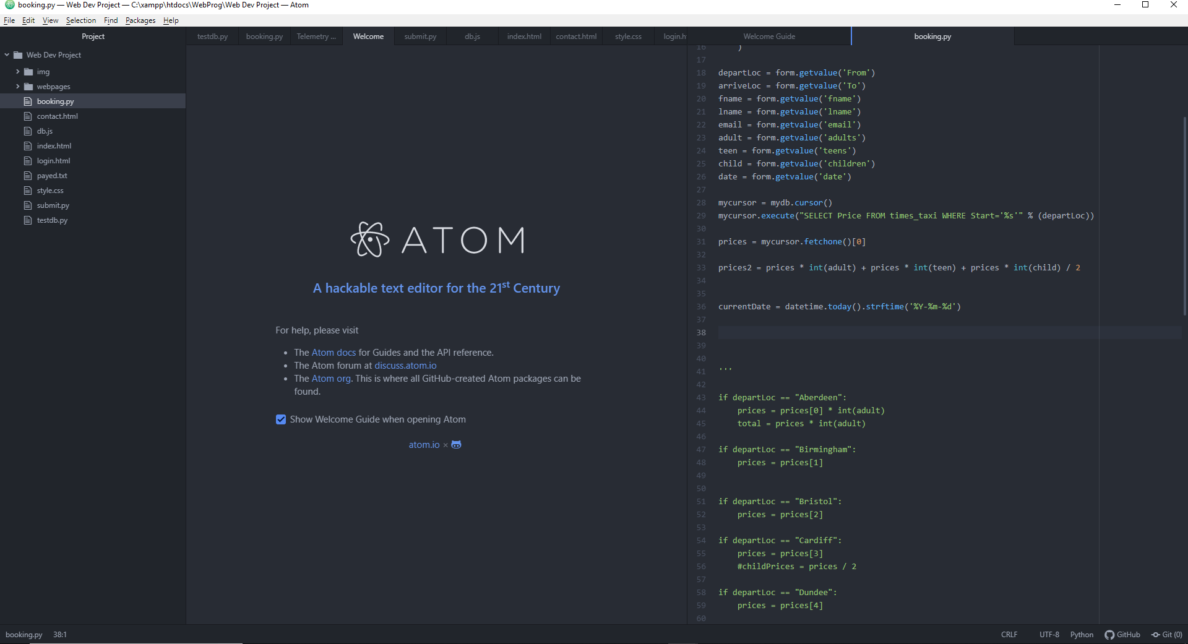
Problems I ran into
I Couldn’t print out the values of the departure and destination.
This is because I added them dynamically from the database.
I fixed this by hard coding it.
I used Python CGI.
This puts each value into an option tag
Tried to fix price with departure location by index however it didn’t work.
This puts interacts with the database and by putting the values into an alphabetically ordered list.
Notes:
Worked on Taxi had to change the database prices and times.
Used the same structure of html across all pages to make the website consistent.
E.G example above is the background image with the title and has a button to the booking page.
Made another folder for images in the same directory that way when we integrate our websites there shouldn’t be a problem with the image loading.
Used Javascript to make sure only the locatons available are selectable did this by using an index of the option tags by emptying them every time and adding the destination specific to the departure location.
Fetched price by one from database as they were already exclusive to the location through the SQL statement select price from table where location is a placeholder of the current location chosen by the user.
Implemented a system where an child can't go without an adult but it doesn't work as intended.
The booking page is purely using python cgi as the button on the homepage “Book a Taxi” is a link to that file.
I did this so I can load the locations from the database into the dropdown menus

Slide 8
Train Travel- Joseph
Problems encountered:
LESP Issues:
Technologies used:
Fetching from database
Passing variables in multiple programs
Copyright
Data protection
Accessible
Disabilities
Testing
HTML
CSS
Python/CGI
JavaScript
MariaDB
Bonus:
Secure admin login
Data validation
Payment(Visa)

Slide 9
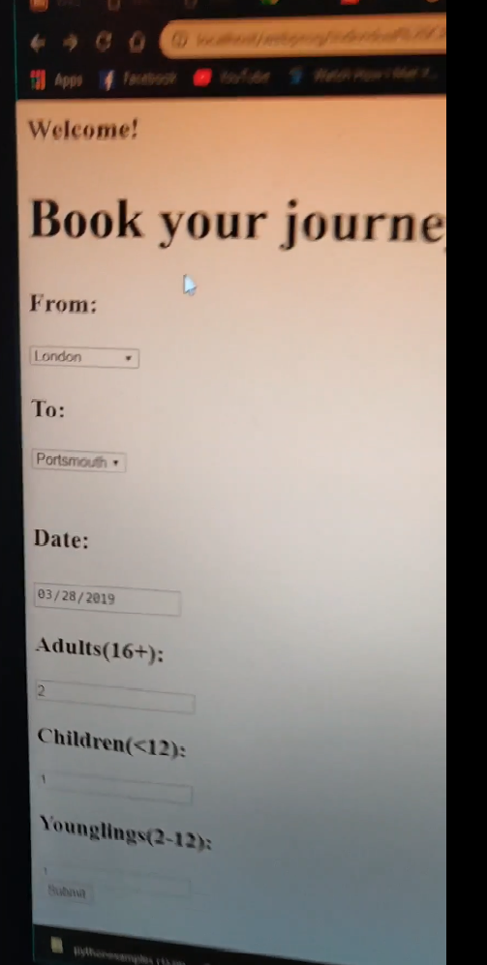
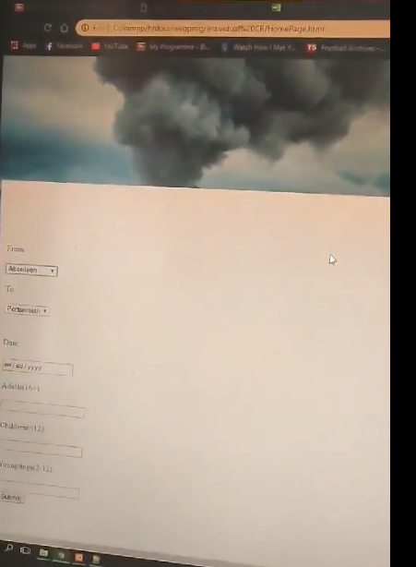
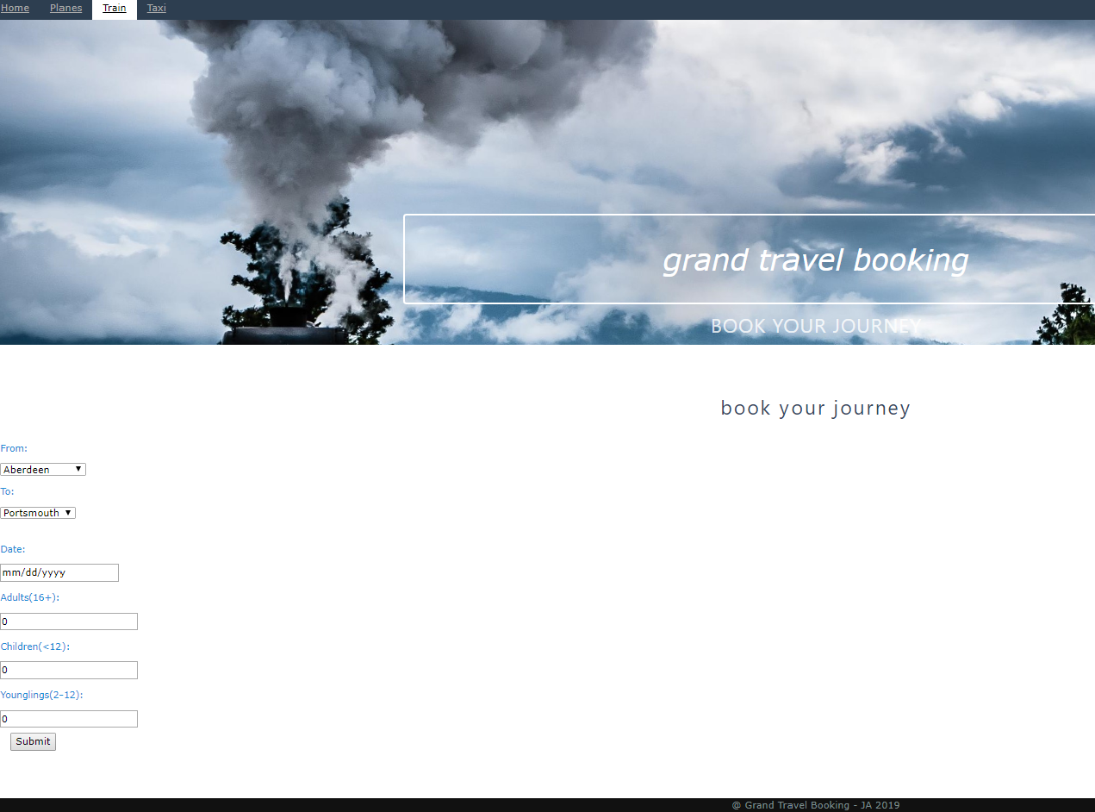

Website prototype/progress
First Stage
Second Stage
FinalStage

Slide 10
HOW DIFFERENT COMPONENTS WERE INTERGRATED
Components moved into common folder
Link addresses changed to work in new folder
Main index page to access each travel mode
Navigation bar on each webpage
SQL tables merged into one database
HOW GROUP WORKED TOGETHER
Worked alongside individually and offered help when asked
Discussed during development how parts would be integrated
Design style kept mostly consistent but didn’t keep together
WHAT WE WOULD DO BETTER
What soft deadlines we should make (planning, modules, etc)
To try and maintain consistant style
The importance of testing
Notes:
We have a group chat and we helped each other if we needed it.
If we were unsure about something we would always discuss it.
Discussed how we are going to integrate the websites together

Slide 11
LESP ISSUES
Images sourced from Copyright Free sites
No obscene of offensive material

